Slide 1
Homework and the Achievement Gap
Kathrine Mortimore @Kathrine_28

Slide 2
Supporting the attainment of disadvantaged pupils (DfE, 2015)

Slide 3
So how can we foster those academic study habits?
Create an appreciation of knowledge acquisition, with work at home directly connected to work in school.
Have clarity over the knowledge students need to have in order to become successful.
Build their confidence by scaffolding the acquisition of knowledge, breaking it down into manageable chunks that are accessed frequently.

Slide 4
Teaching and Learning Cycles
cycles per year
weeks per cycle
Weeks teaching
Assessment Super teaching

Slide 5
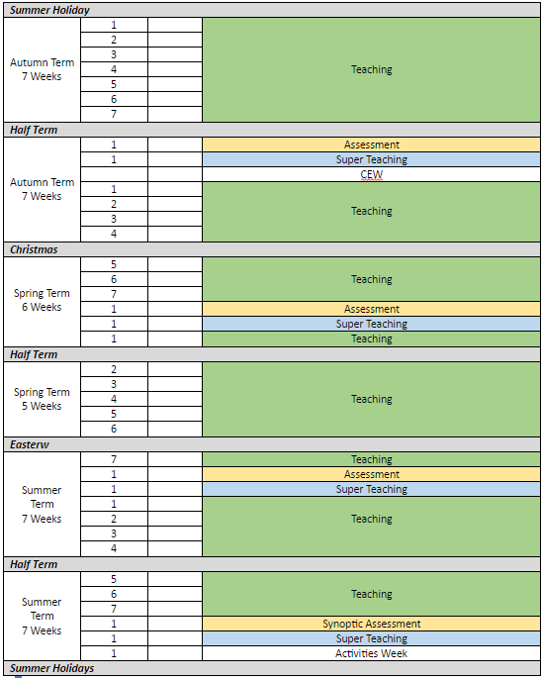
Teaching and Learning Cycles

Slide 6
Assessment - Skills / Predicted grades
This is
What you do in lessons
How you answer questions
What you write in your book
It is tested by
The teacher listening to your answers
Extended pieces of writing (Yellow sticker tasks)
What you write in your books

Slide 7
Assessment - Knowledge
This is
Your Knowledge Organisers
The content of your lessons
What you do for homework
It is tested by
A test in week 8 of each teaching and learning cycle

Slide 9
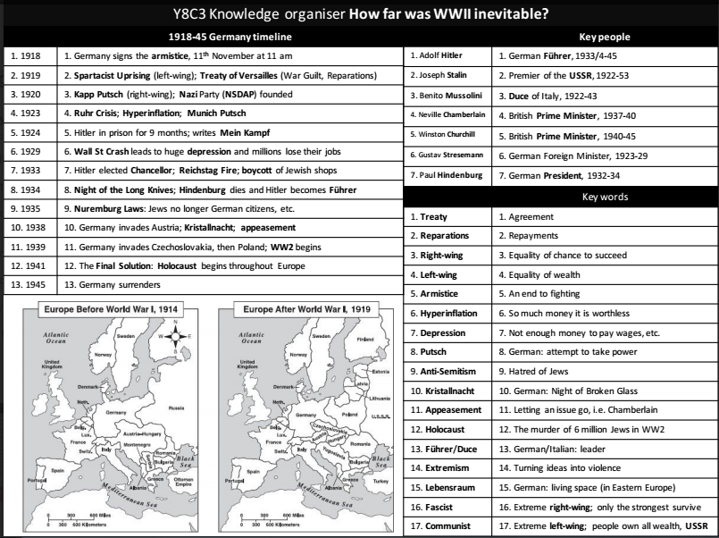

Slide 10
ACT | PLOT
1 | In Italy two noble families, the Montagues and Capulets, have much bad blood between them. Romeo, son of old Montague, is in love with Rosaline, who disdains his love. As a result, Romeo is depressed. To cure him of his love, his friend Benvolio induces him to attend a masked ball at the Capulets, where he could encounter other beauties and forget Rosaline. At the ball, Romeo is attracted by a girl who he learns is Juliet, daughter of the Capulets. They seal their love with a kiss.
2 | Romeo lingers in Capulet’s garden, standing in the orchard beneath Juliet’s balcony. He sees Juliet leaning over the railing, hears her calling out his name, and wishes that he were not a Montague. He reveals his presence, and they resolve, after an ardent love scene, to be married secretly.
3 | Tybalt encounters Romeo returning from Friar Lawrence’s cell. Romeo, softened by his newfound love and his marriage to Juliet, refuses to be drawn into a quarrel with Tybalt, now his kinsman by marriage. Mercutio grapples with Tybalt and is killed. Aroused to fury by the death of his friend, Romeo fights with Tybalt and kills him and takes shelter in the Friar’s cell.
4 | In despair, Juliet seeks Friar Lawrence’s advice. He gives her a sleeping potion, which for a time will cause her to appear dead. Thus, on the day of her supposed marriage to Paris, she will be carried to the family vault. By the time she awakens, Romeo will be summoned to the vault and take her away to Mantua.
5 | The Friar’s letter fails to reach Romeo. When he hears of Juliet’s death Romeo procures a deadly poison from an apothecary and secretly returns to Verona to say his last farewell to his deceased wife and die by her side. At Juliet’s side, Romeo drinks the poison and dies. When Juliet awakens from her deep sleep, she realises Romeo’s error and kills herself with his dagger. The Capulets and Montague decide to reconcile as a result of the deaths of their children.
CHARACTERS
1. Romeo Montague | Intense, intelligent, quick witted, and loved by his friends.
2. Juliet Capulet | Naïve and sheltered at the beginning, develops into a woman with strength.
3. Mercutio | Romeo’s close friend. Wild, playful and sarcastic.
4. Tybalt | Juliet’s cousin. A hothead consumed by issues of family honour. Hates the Montagues.
5. Benvolio | Romeo’s cousin, less quick witted than Romeo and Mercutio, tries to keep the peace.
6. Friar Lawrence | A Franciscan monk and a friend to both Romeo and Juliet.
7. Nurse | Juliet's best friend and confidante, and in many ways is more her mother than Lady Capulet is.
KEY VOCAB
1. UNREQUITED LOVE Love that is not felt in the same way by another person
2. COURTLY LOVE A medieval code of behaviour between lovers
3. HONOUR To feel you must do something because it is morally right
4. TRAGEDY A play about death or suffering
5. RENAISSANCE A period of new interest in art and literature in Europe during the 15 and 16th centuries
6. GRUDGE A strong feeling of anger or dislike for someone who has treated you badly
7. FATE A power that some people believe controls all events
8. FATALISM The belief that people cannot change the way events will happen
9. FREEWILL The ability to decide what to do independently of any outside influences.
CONTEXT
PLAYWRIGHT: William Shakespeare born 1564 Stratford , died 1616 | Romeo and Juliet –William Shakespeare
FACTS: One of Shakespeare’s most famous tragedies. Set in Verona , Italy. It is generally believed the play originated from a true Italian love story of the 3rd Century
LITERARY CONTEXT: Written during the Elizabethan Era otherwise known as The Renaissance-a time of significant change in the fields of religion, science nature and the arts
KEY QUOTES
1. “Two households, both alike in dignity, In fair Verona, where we lay our scene, From ancient grudge break to new mutiny, Where civil blood makes civil hands unclean. From forth the fatal loins of these two foes, A pair of star-cross'd lovers take their life”
2. “My only love sprung from my only hate! Too early seen unknown, and known too late!.”
3. “But, soft! what light through yonder window breaks? It is the east, and Juliet is the sun
4. “O Romeo, Romeo! wherefore art thou Romeo? Deny thy father and refuse thy name; or, if thou wilt not, be but sworn my love, And I'll no longer be a Capulet.”
SUBJECT TERMINOLOGY
1. Verse: Writing arranged in short lines with a regular rhythm
2. Prose: Written language in ordinary form
3. Soliloquy: A speech that a character says to themselves or the audience alone on stage
4. Sonnet: A poem of 14 lines
5. Oxymoron: Two words used together that have opposite meanings
6. Blank Verse: 10 syllable lines of verse that do not usually rhyme
7. Iambic Pentameter: Lines of 10 syllables with emphasis on the 2nd, 4th, 6th, 8th and 10th syllable
8. Dramatic Irony: When the audience know something the characters do not
9. Monologue: A long speech by one peson
10. Imagery: Visually descriptive language
THEMES
LOVE
FATE V FREE WILL
FAMILY HONOUR
PLAY ON WORDS

Slide 11
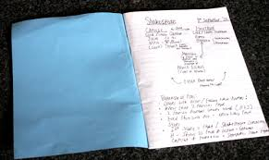
How will homework look?
Students will be expected to revise a section of the knowledge organiser each evening.
As evidence of this revision, they should record their notes in their practice books.

Slide 12
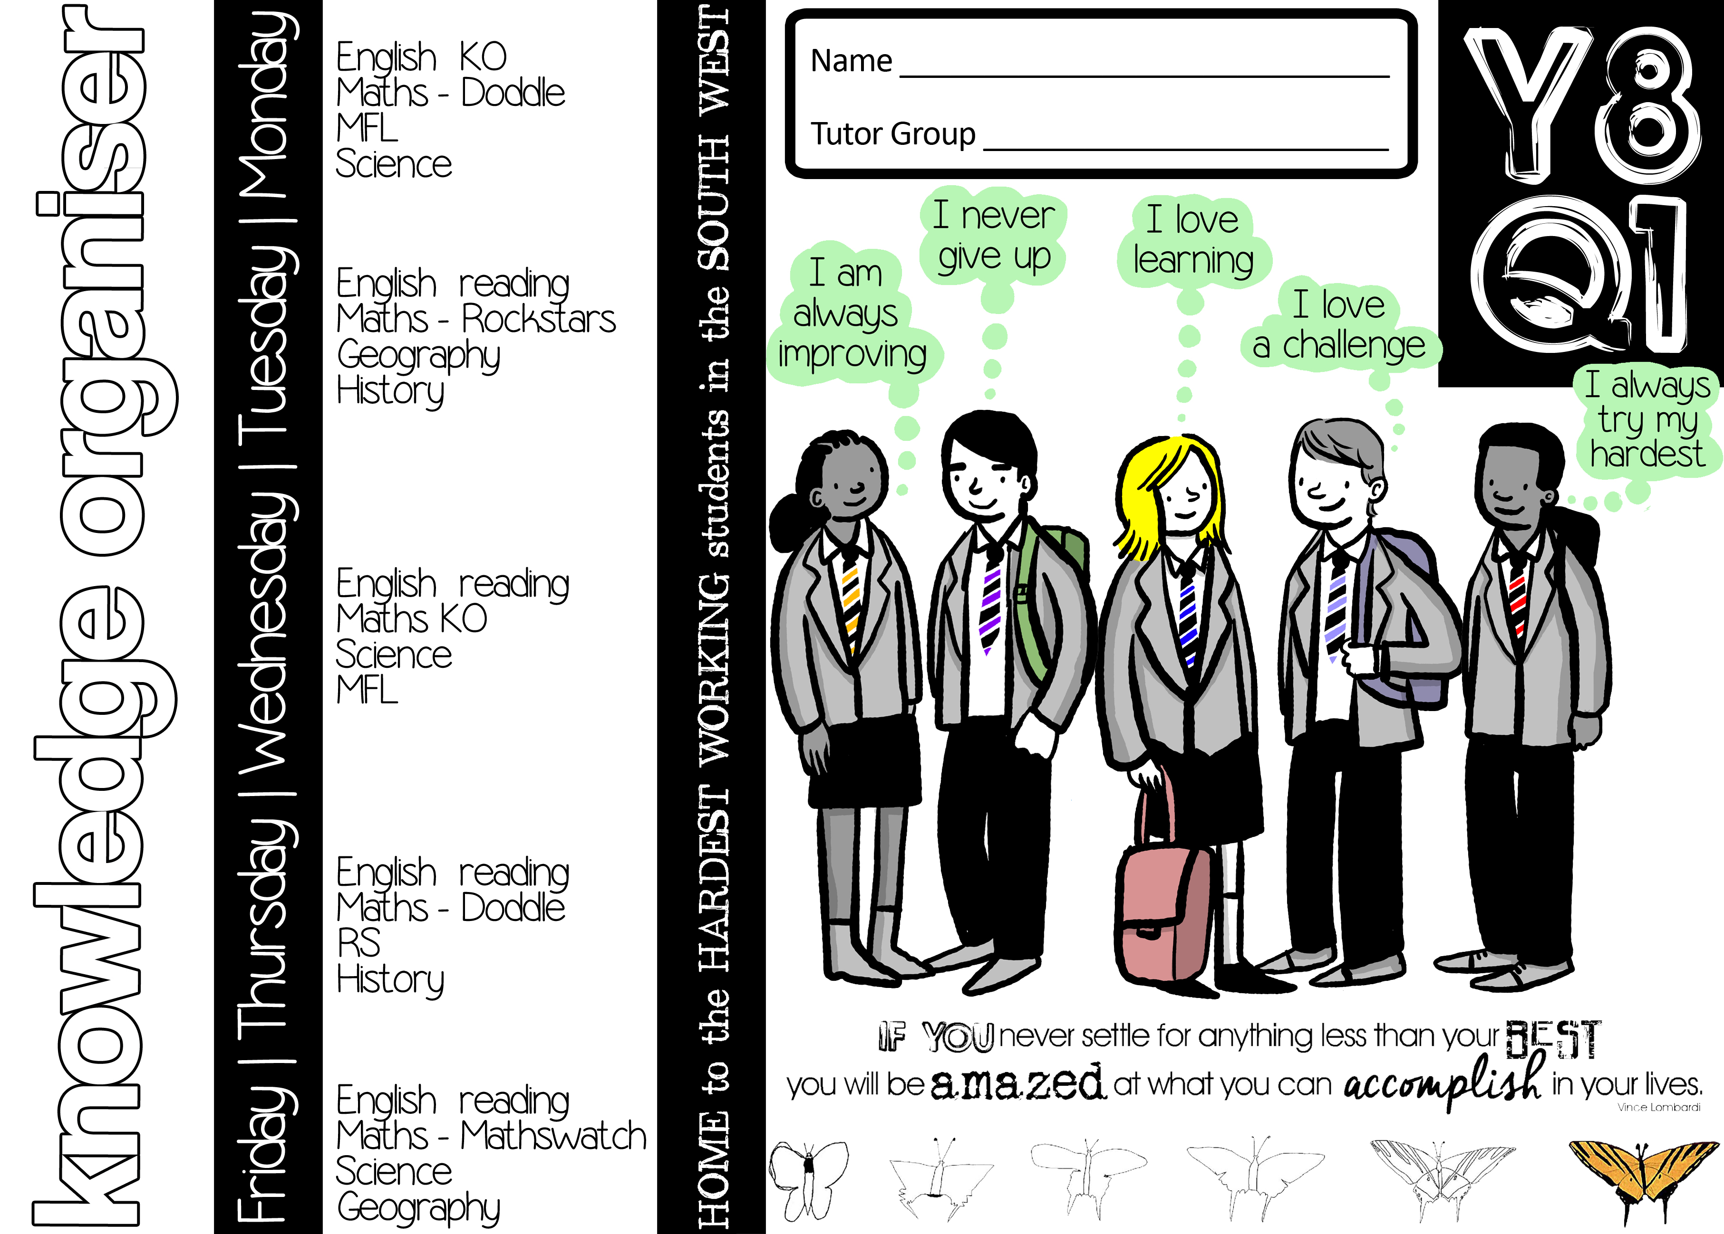

Slide 13
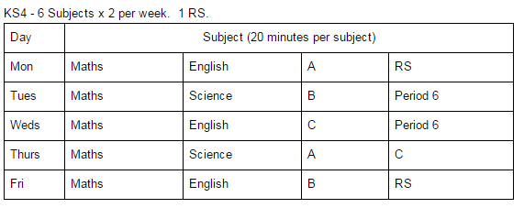
Homework Timetable 9, 10 & 11
One homework at KS4 should be the knowledge organiser revision, the other should be a practice exam question.
As they progress through the course students may move on to adapt their revision strategies to suit them, e.g. through creating flash cards or mindmaps.

Slide 14
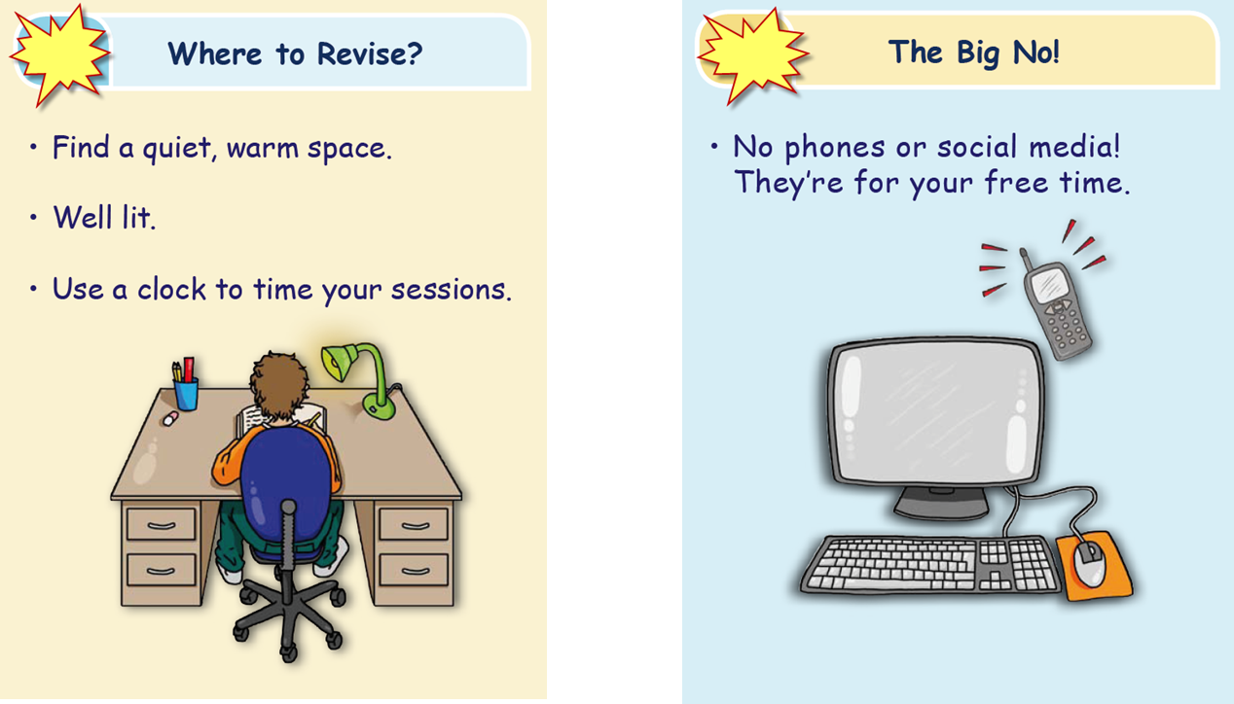

Slide 15
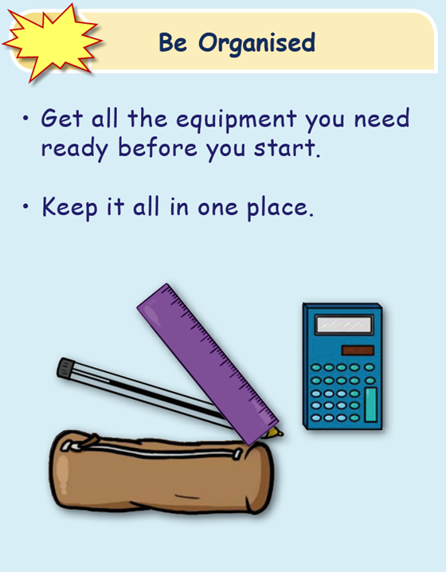

Slide 16
How to learn your Knowledge Organiser
You have 2 x 20 minute homeworks for each subject spread over the week.
Where you are given a Knowledge Organiser to learn you should follow
Session 1.
Read, cover, write, check
Session 2.
Either
turn you notes into either, pictures(with words), mind maps, story boards etc (Dual Coding)
OR
quiz yourself - produce quizzes to test your knowledge (Self Testing)

Slide 17
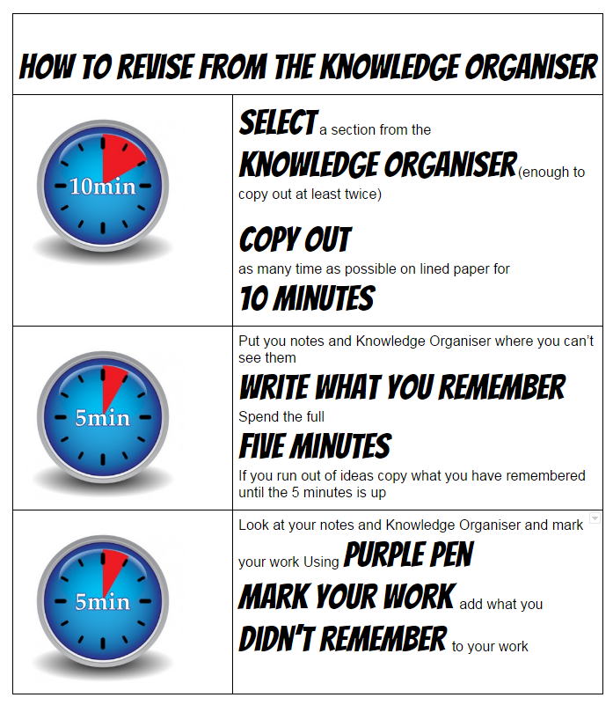
Knowledge Organiser
Homework
1

Slide 18
Select a section from the knowledge organiser (enough to copy out at least twice)
Copy out as many time as possible on lined paper for 10 minutes.

Slide 19
Shut your Knowledge Organiser
Turn over the page
Write down as much as you can remember

Slide 20
Look at your notes and Knowledge Organiser
Add what you didn’t remember to your work in purple pen

Slide 21
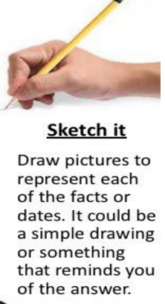
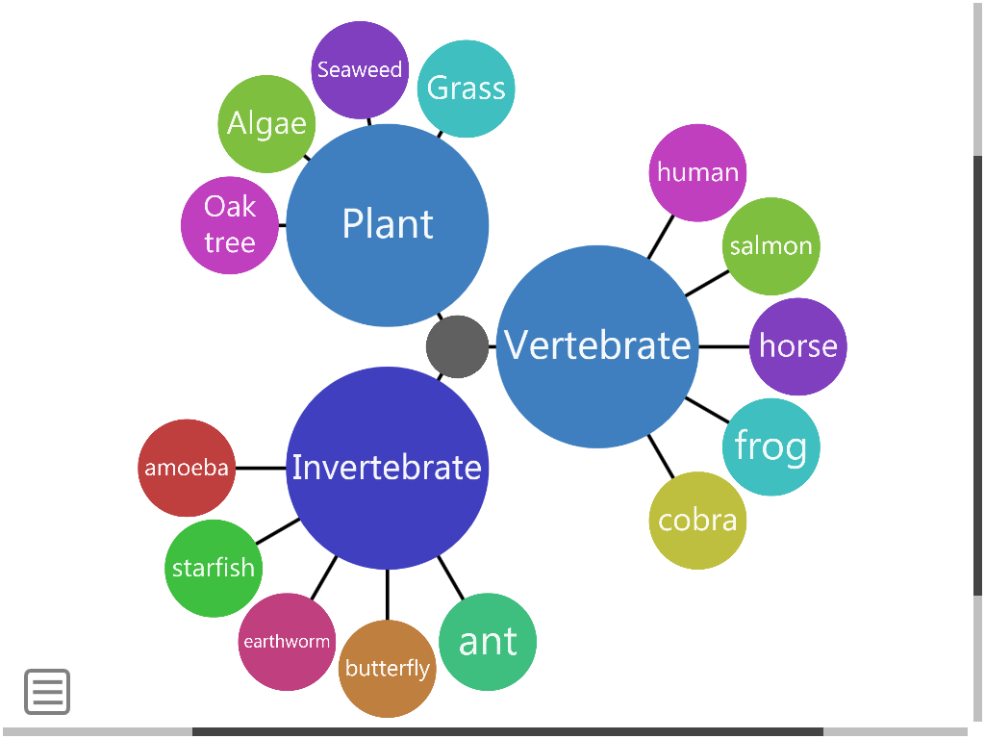
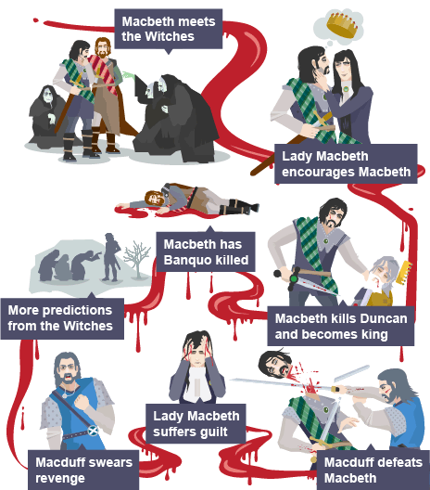
Find homework one for this subject
Knowledge Organiser
Dual Coding
2
Use you notes from your first homework this week
Spend 10 minutes turning your notes into either:
a spider diagram
pictures
bullet points
a storyboard/ timeline
Notes:
On the second homework don’t do the read, copy write
Turn your notes and KO into one of the above

Slide 22
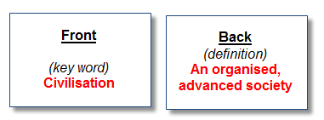
Self testing
On one side of paper write a list of key terms. On the other side write the meanings
You could create flash cards
Key term on one side of a card, the definition on the other
Question on one side of a card, answer on the other
Statement on one side of the card, true or false on the other
Design some questions -who,what,when,where,why,how
Write the questions on one side, write the answers on the other
On one side of paper write a list of statements, some true and some false.
On the other side write the answers

Slide 23
Look at your notes and Knowledge Organiser
Using you book or cards write out keyword or questions
On the other side write the definition or answer

Slide 24
Now test yourself
Look at the keywords or questions and write down the answers
Now check the answer - for those you got wrong write out the keyword or question and the definition or answer to put it into your long term memory

Slide 25
Checking
Line up
You will be expected to have your homework folder out in line-up
Year 9-11
This means your homework folder in your plastic wallet
Tutor
You will be expected to get your homework folder out of your plastic wallet
Open your book/folder for your tutor to check you have done your knowledge Organiser homeworks
Year 9-11 - subject teachers will check your subject homework

Slide 26
Practice book will be checked by tutors as part of the readiness to learn check.
Each page of the book clearly numbered - straightforward to see correct work completed. All students complete same homework at the same time.
Tutor check
Incomplete practice books will result in a same day lunchtime DT, supervised by the Lead Practitioners [this has since been merged with a whole school system].
Lunchtime DT
Failure to attend will result in an hour after school.
Hour After School

Slide 27
Summary
Staff are not be expected to set homework.
Staff are not be expected to chase up the completion of homework, or set detentions for incomplete work.
In years 9, 10 & 11 teachers are expected to collect in the examination responses on the exam date and either mark them or devise a method of meaningful self/peer assessment in class.

Slide 28
Problems & Next Steps
Varying quality of knowledge organisers.
Best departments carry out regular in class quizzing directly related to knowledge organisers.
A move towards a merging of detentions for all misdemeanours has diluted the impact of original DTs.
Prolonged tutor absence led to some inconsistencies.

